Slide 1
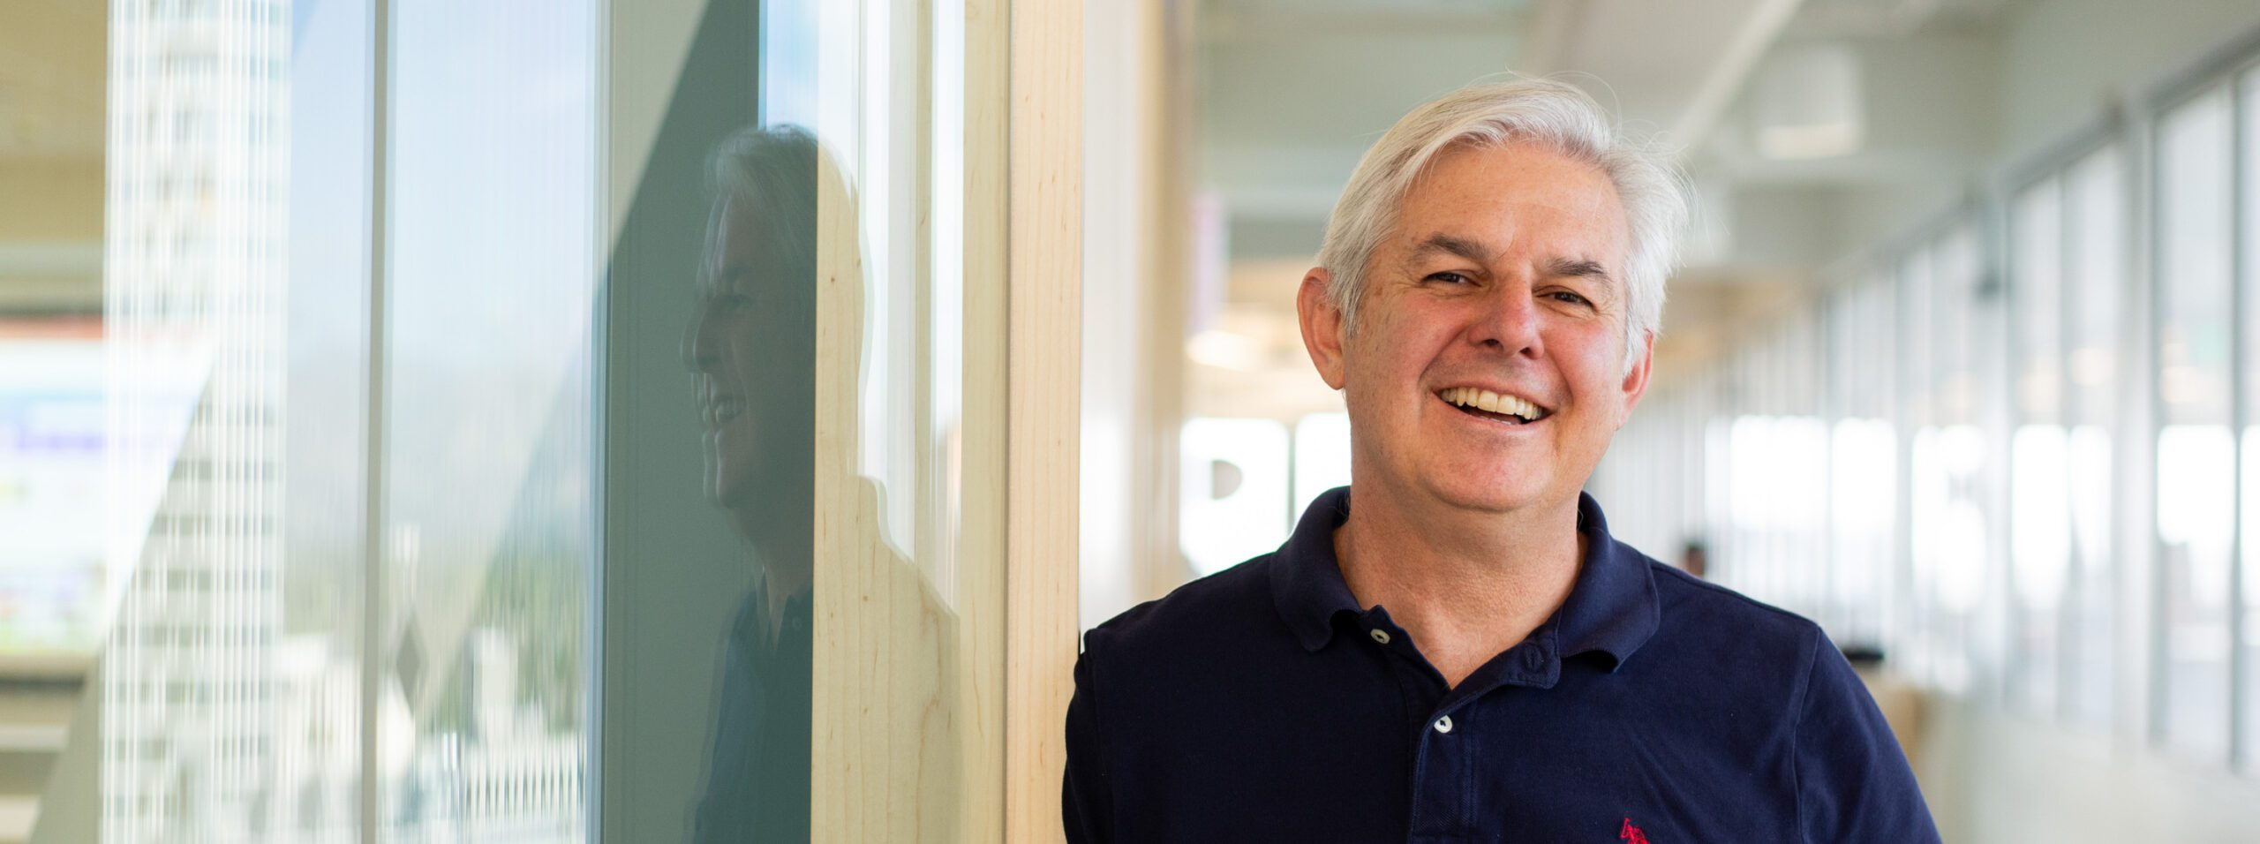
CIKM-2023 Tutorial: Some Useful Things to Know When Combining IR and NLP: the Easy, the Hard and the Ugly
Omar
Ken
Omar Alonso, Amazon, Santa Clara, CA, USA
Kenneth Church, Northeastern University, San Jose, CA, USA

Slide 2
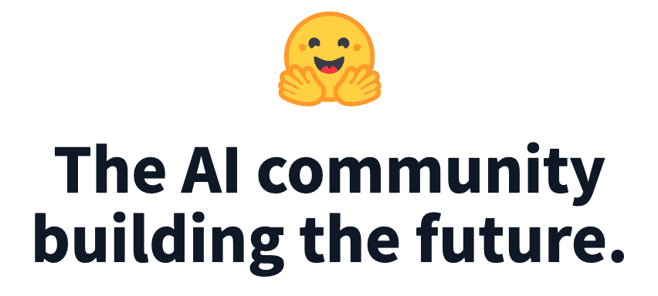
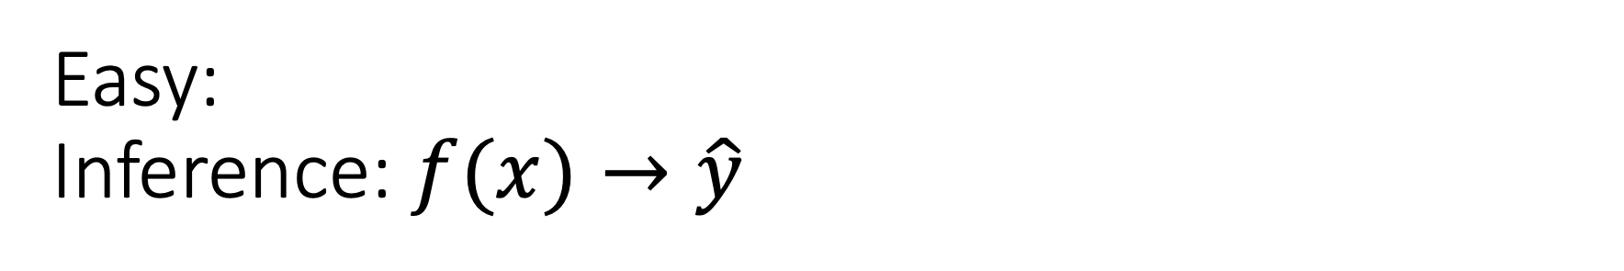
Easy: Inference: $f(x)→\hat{y}$
Classification
Sentiment
Emotion
Hate Speech
Guess Missing Word
Part of Speech Tagging
Question Answering (SQuAD)
Entailment (GLUE)
Machine Translation
Speech
Speech-to-Text
Text-to-Speech
Vision
Classify Objects
Add Captions
HuggingFace

Slide 3
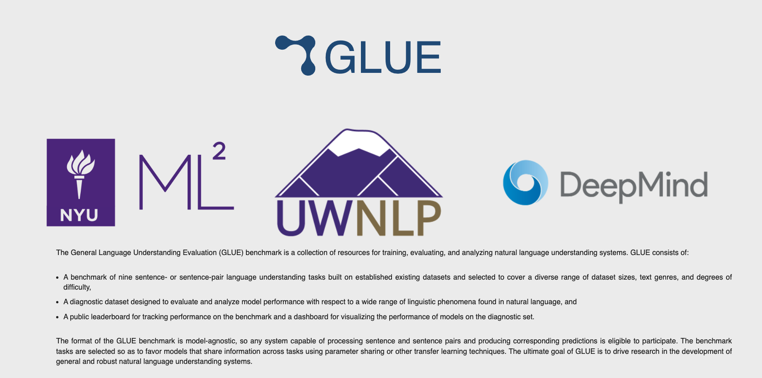
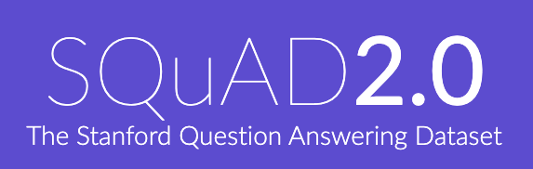
Two Popular Datasets
https://gluebenchmark.com/
https://rajpurkar.github.io/SQuAD-explorer/

Slide 4
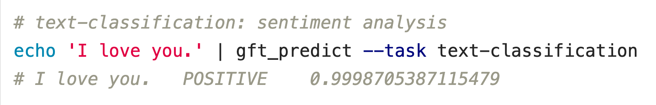



Classification
$$f\left(x\right)→\hat{y}$$
No model specified
$$x$$
$$\hat{y}$$
Score

Slide 5
Input: I love you Output: Depends on Model (among other things)
Task: classify
Models:
Sentiment
Expected output label: positive
Fake News:
Expected output label: not fake (real)
Spam/Ham:
Expected output label: not spam (ham)
for model in …
do
echo I love you |
gft_predict \
--task classify \
--model $model
done

Slide 6
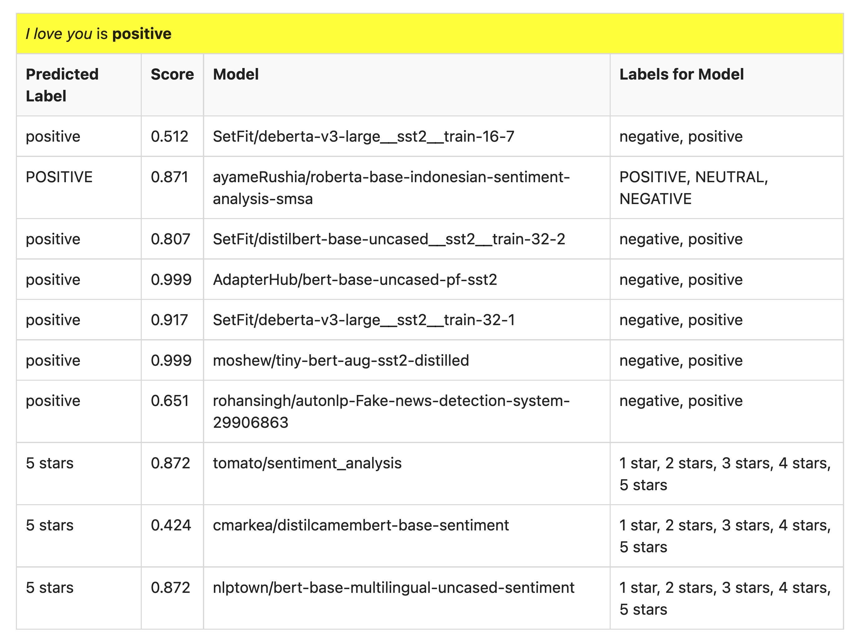
Many of these models produce reasonable results
Scores could be more confident

Slide 7
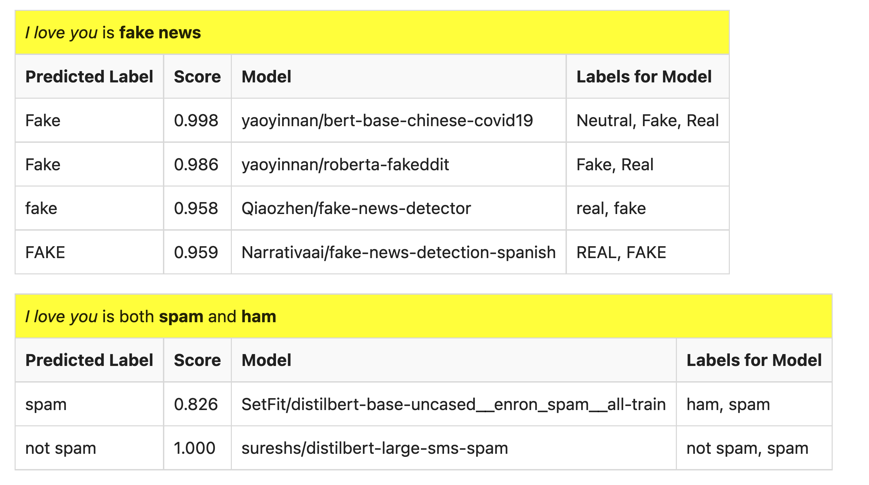
But…

Slide 8
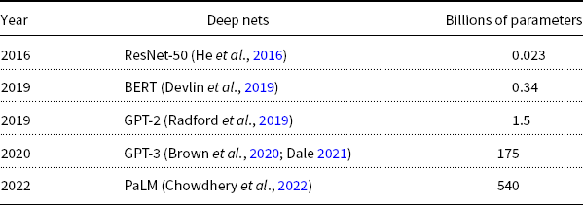
Hard: Pre-Training Large Language Models (LLMs)
GPT-3
PaLM
GPT-2
BERT
ResNet
Most users should not invest in pretraining
because growth (& costs) are out of control

Slide 9

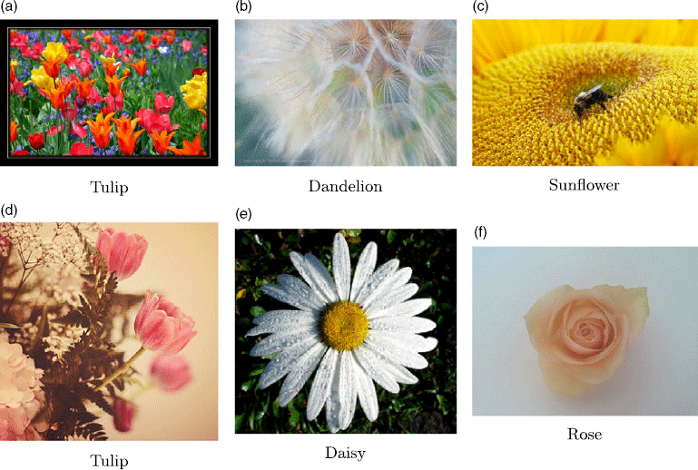
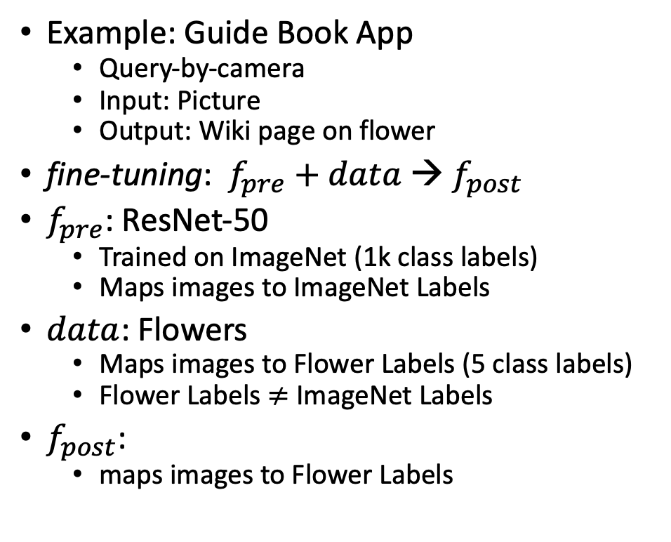

Not So Hard: Fine-Tuning
$$data$$
Flowers
Example: Guide Book App
Query-by-camera
Input: Picture
Output: Wiki page on flower
fine-tuning: $f_{pre}$ $+ data$→ $f_{post}$
$f_{pre}$: ResNet-50
Trained on ImageNet (1k class labels)
Maps images to ImageNet Labels
$data$: Flowers
Maps images to Flower Labels (5 class labels)
Flower Labels $≠$ ImageNet Labels
$f_{post}$:
maps images to Flower Labels

Slide 10
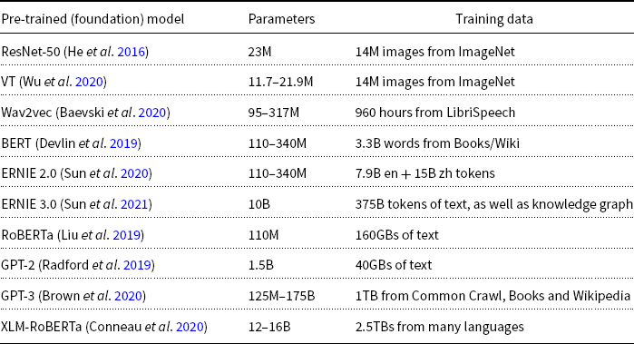
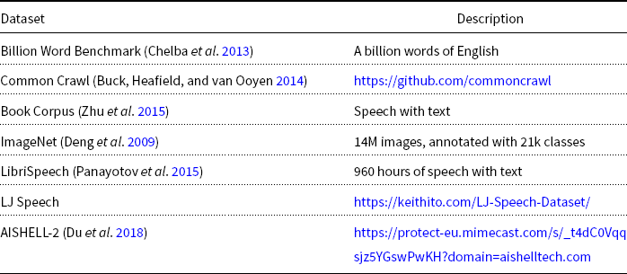
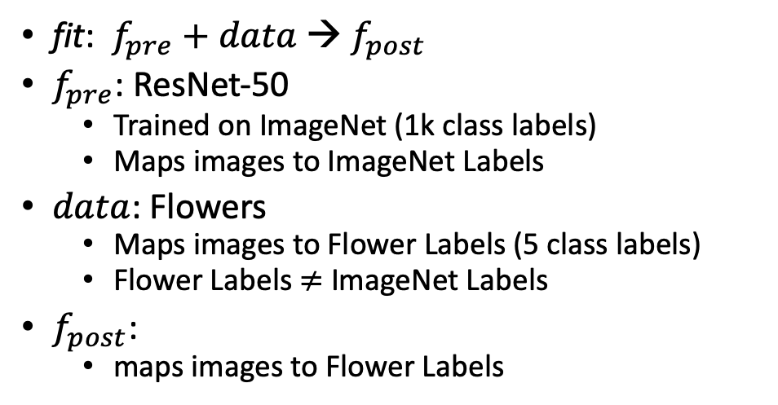

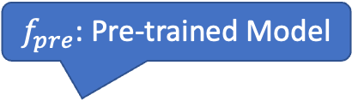
What is fine-tuning fit?
Flowers
$$data$$
fit: $f_{pre}$ $+ data$→ $f_{post}$
$f_{pre}$: ResNet-50
Trained on ImageNet (1k class labels)
Maps images to ImageNet Labels
$data$: Flowers
Maps images to Flower Labels (5 class labels)
Flower Labels $≠$ ImageNet Labels
$f_{post}$:
maps images to Flower Labels
$f_{pre}$: Pre-trained Model

Slide 11
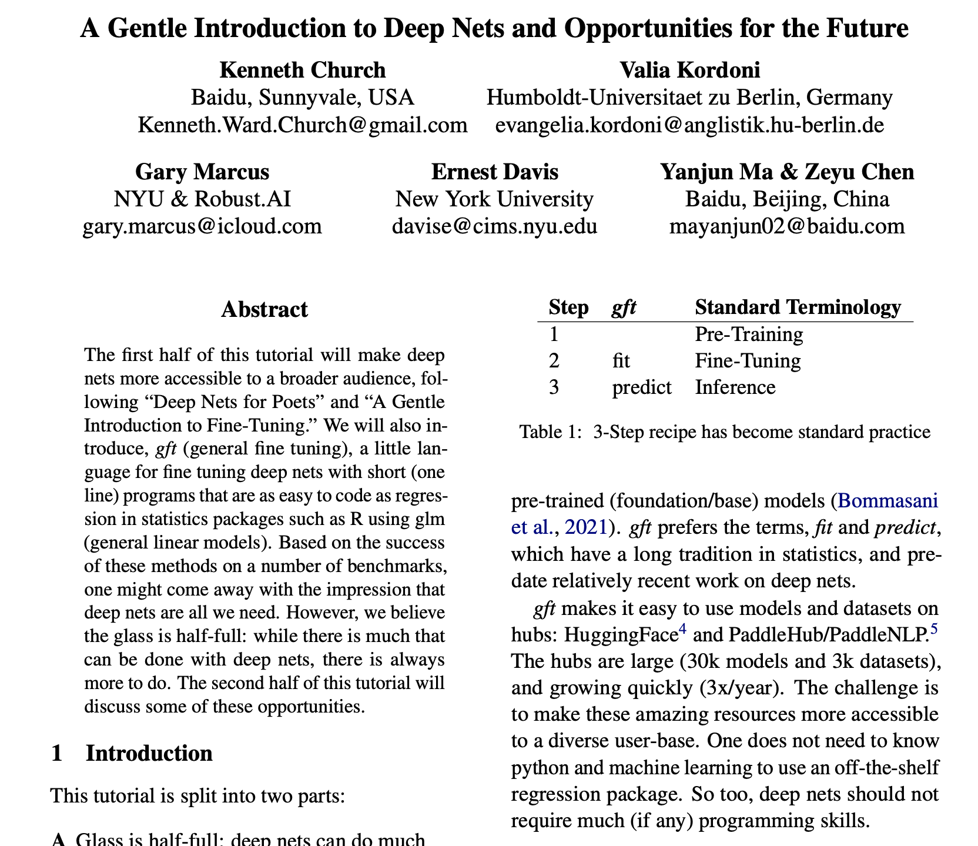
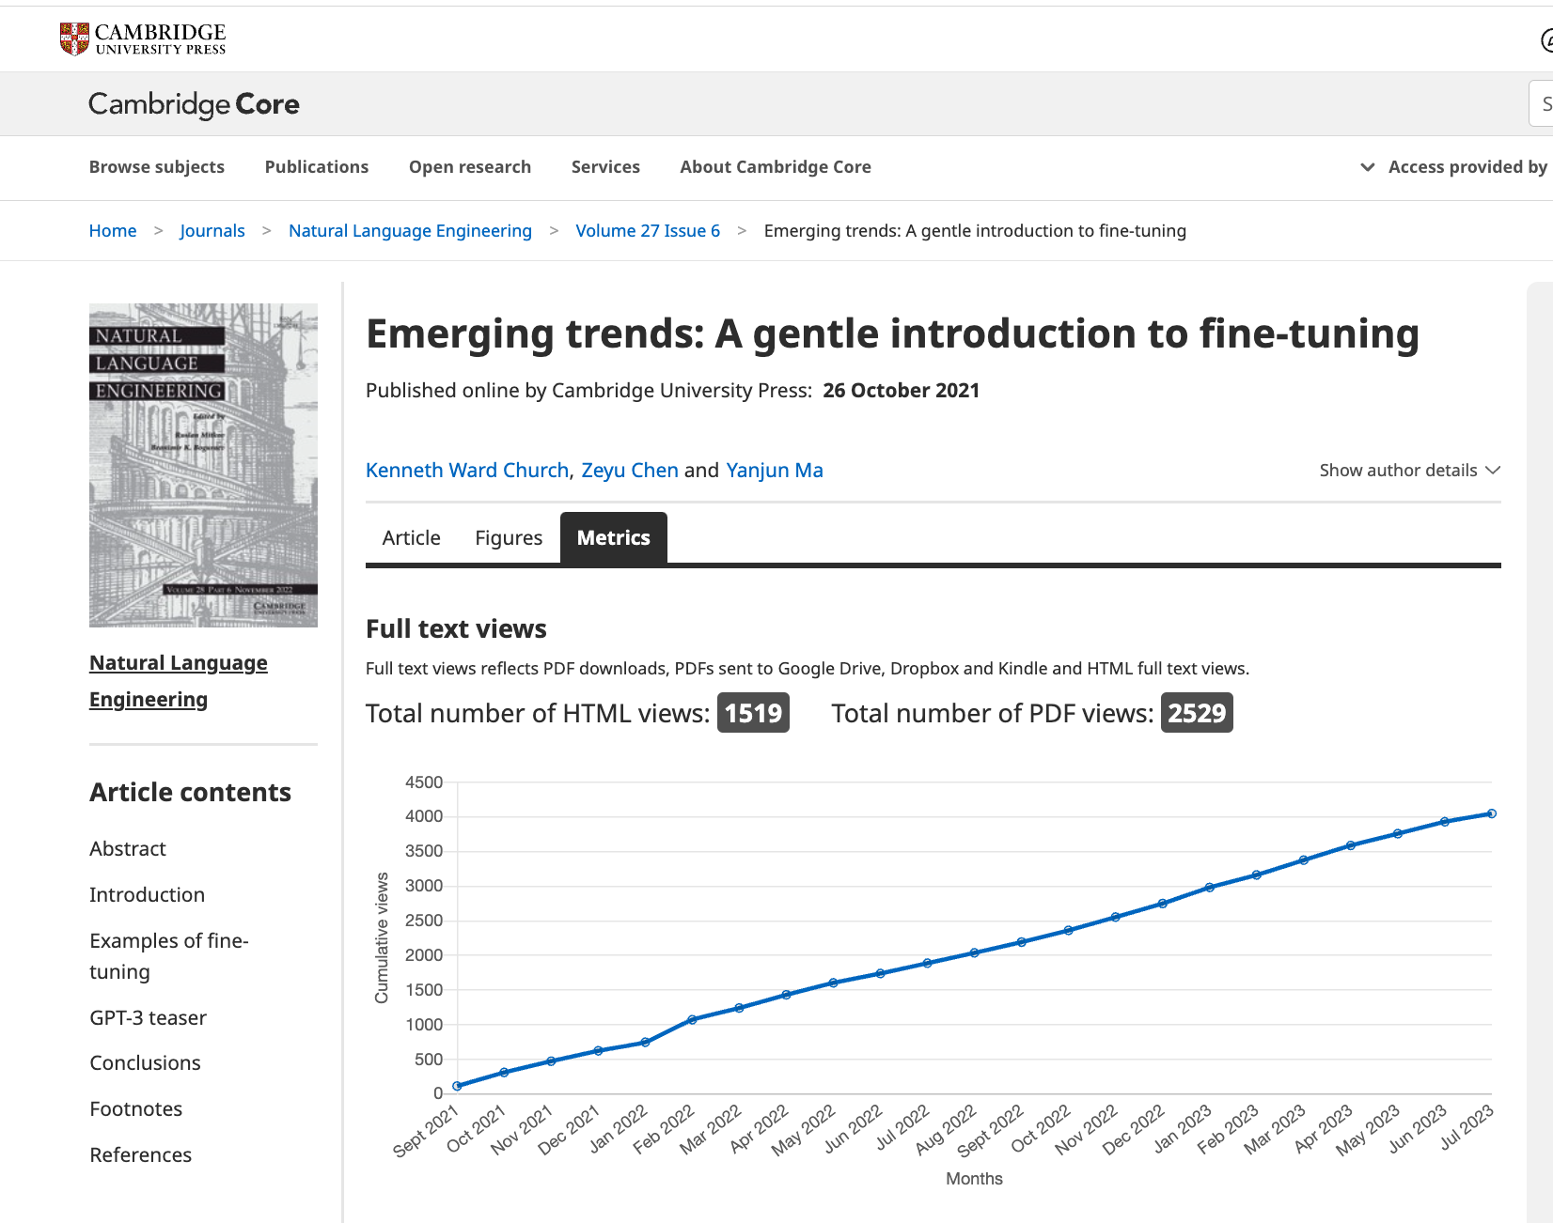
Shameless Plugs
https://github.com/kwchurch/ACL2022_deepnets_tutorial

Slide 12
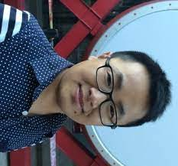
ACL-2022 Tutorial: Part A: Simple Uses of Deep Nets
Ken
Valia
Gary
Ernie
Yanjun
Zeyu
Ken Church, Baidu, USA
Valia Kordoni, Humboldt-Universitaet zu Berlin, Germany
Gary Marcus, Robust.AI
Ernest Davis, NYU
Yanjun MA, Baidu, China
Zeyu Chen, Baidu, China

Slide 13
Outline
Make deep nets accessible to masses (including non-programmers)
Part A: Glass is half-full
Deep nets can do much
Part B: Glass is half-empty
There is always more work to do
Advocate combo of Part A with
AI Knowledge Representation
Linguistics and Philosophy
GFT Code,
100s of examples,
slides, videos, papers

